Slide 1
PG & RESEARCH DEPARTMENT OF ZOOLOGY
GOVERNMENT ARTS COLLEGE, COIMBATORE
Wildlife Week Celebrations & Zoology Association Function

Slide 2
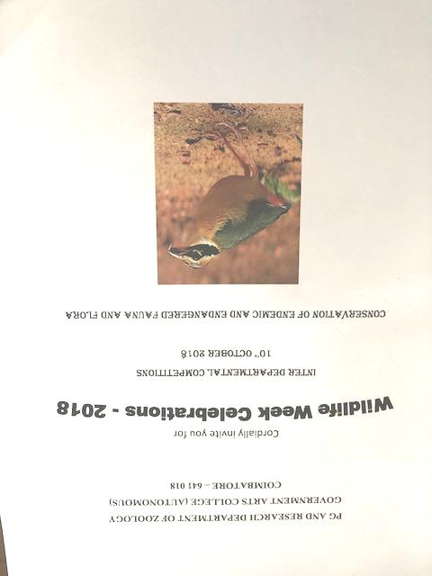
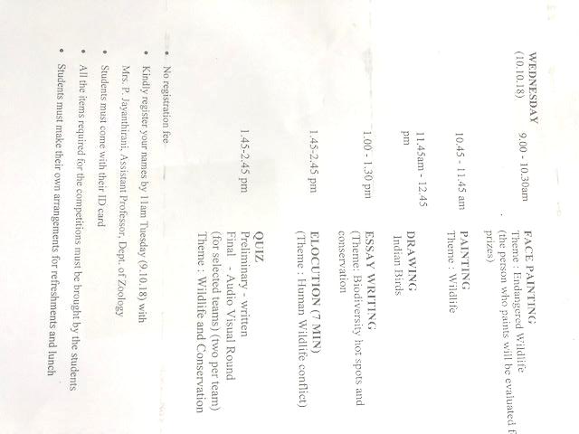

Slide 3
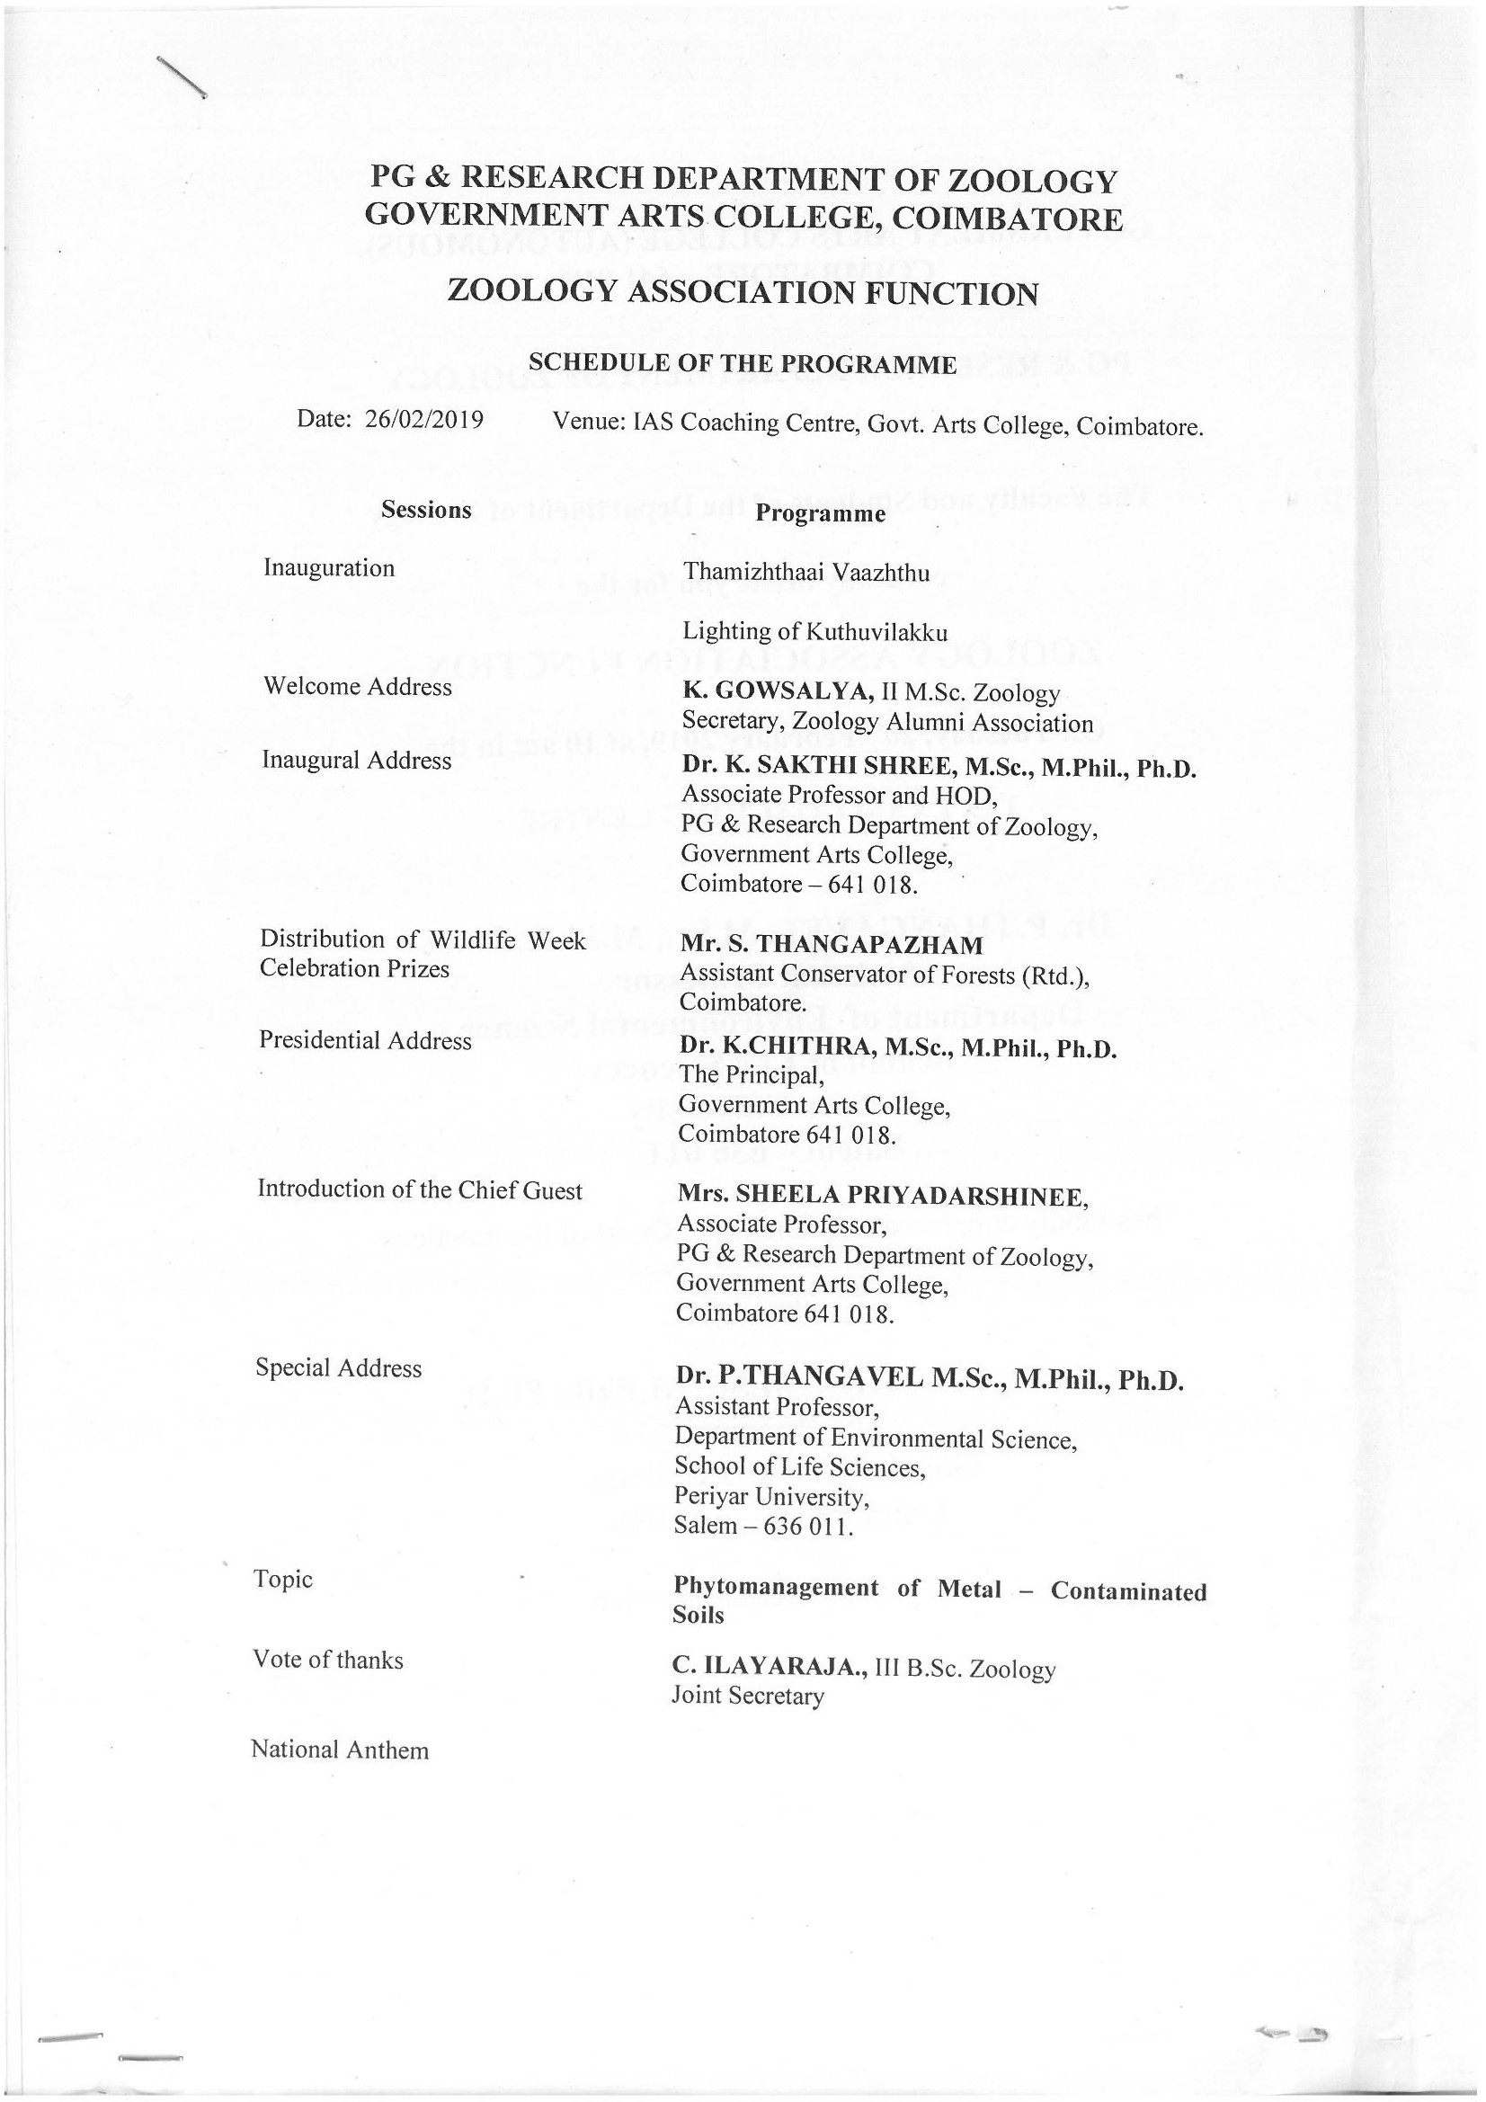

Slide 4
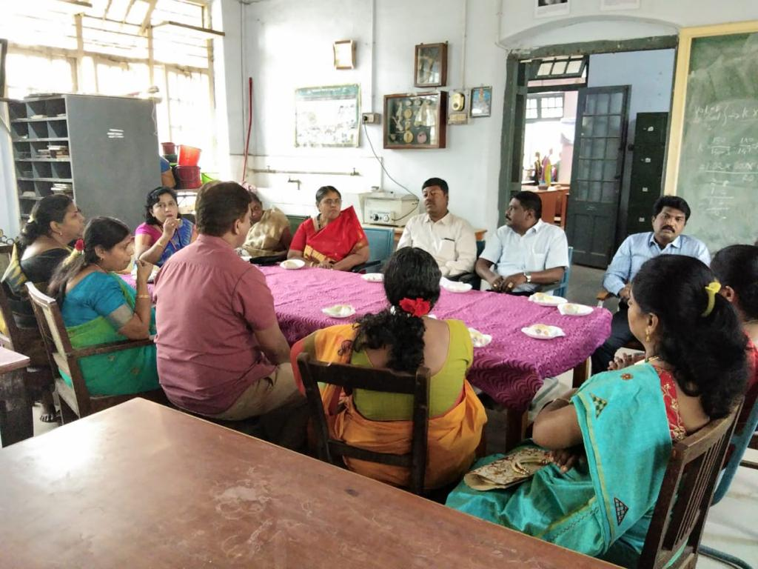
Wildlife Week Celebrations &
Zoology Association Function
Tea with the Guest-of-Honor

Slide 5
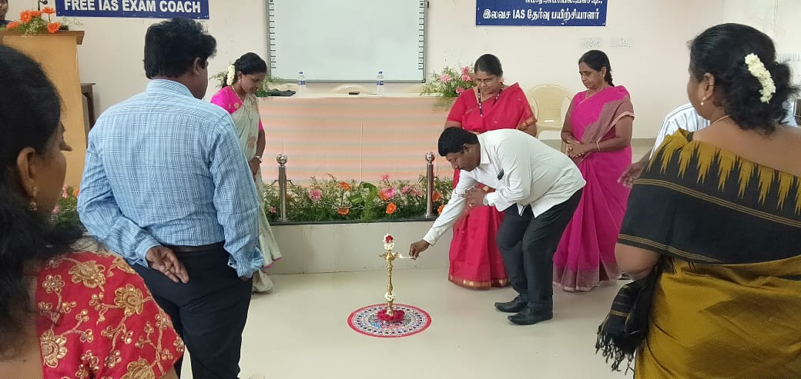
Wildlife Week Celebrations &
Zoology Association Function
Ceremonial Lighting of the Lamp by the Guest-of-Honor

Slide 6
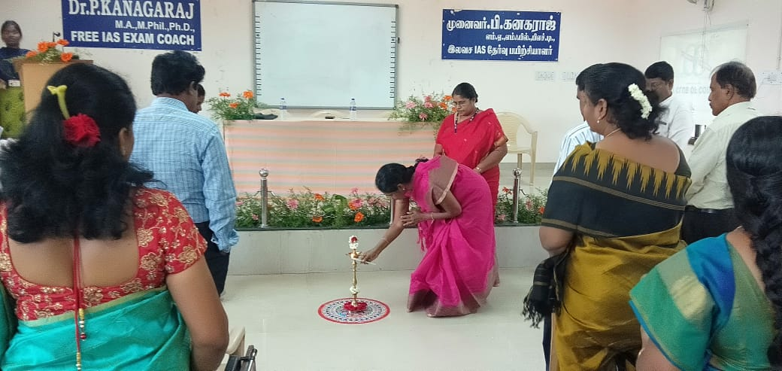
Wildlife Week Celebrations &
Zoology Association Function
Ceremonial Lighting of Lamp by Principal, Govt. Arts College

Slide 7
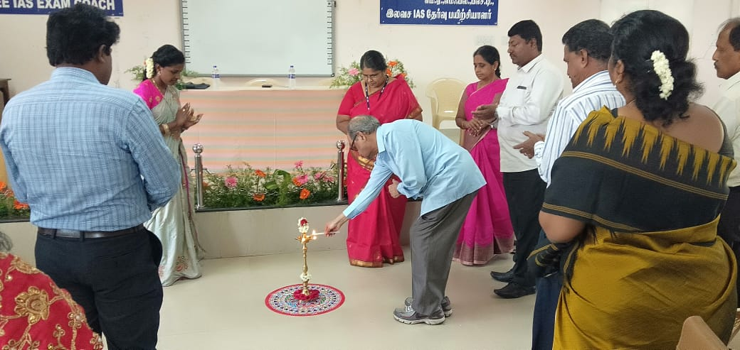
Wildlife Week Celebrations &
Zoology Association Function
Ceremonial Lighting of the Lamp by Distinguished Alumni

Slide 8
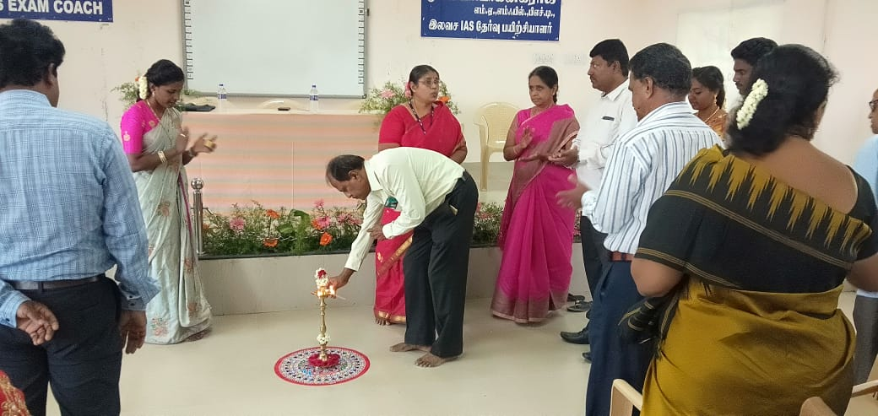
Wildlife Week Celebrations &
Zoology Association Function
Ceremonial Lighting of the Lamp by Distinguished Alumni

Slide 9
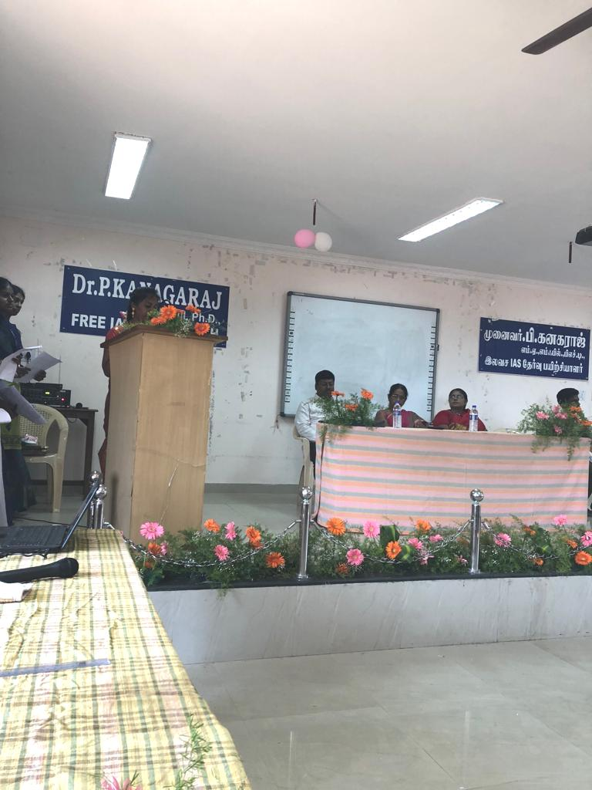
Wildlife Week Celebrations &
Zoology Association Function
Welcome Address: K. Gowsalya, Secretary, Zoology Association

Slide 10
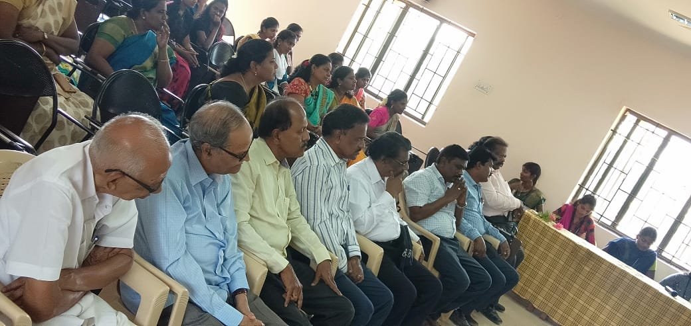
Wildlife Week Celebrations &
Zoology Association Function
Active Participation by Alumni and Students

Slide 11
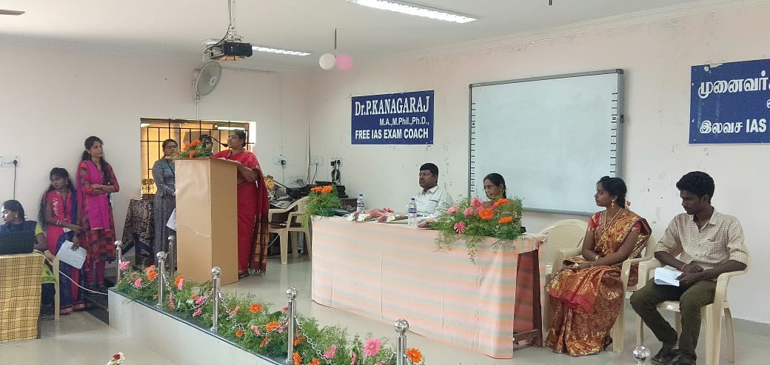
Wildlife Week Celebrations &
Zoology Association Function
Inaugural Address: Dr. K. Sakthi Shree, Head, Dept. of Zoology

Slide 12
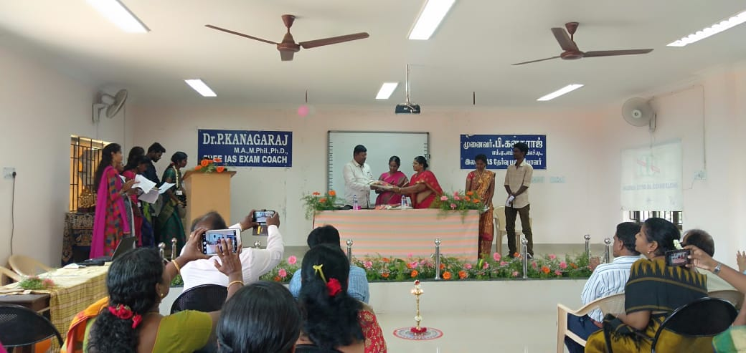
Wildlife Week Celebrations &
Zoology Association Function
Felicitating the Guest-of-Honor

Slide 13
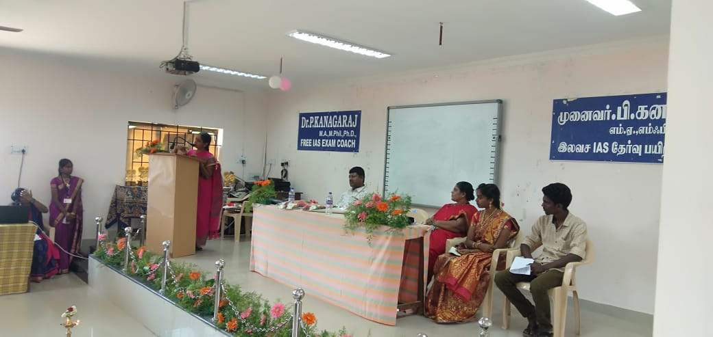
Wildlife Week Celebrations &
Zoology Association Function
Presidential Address: Dr. K. Chitra, Principal, Govt. Arts College

Slide 14
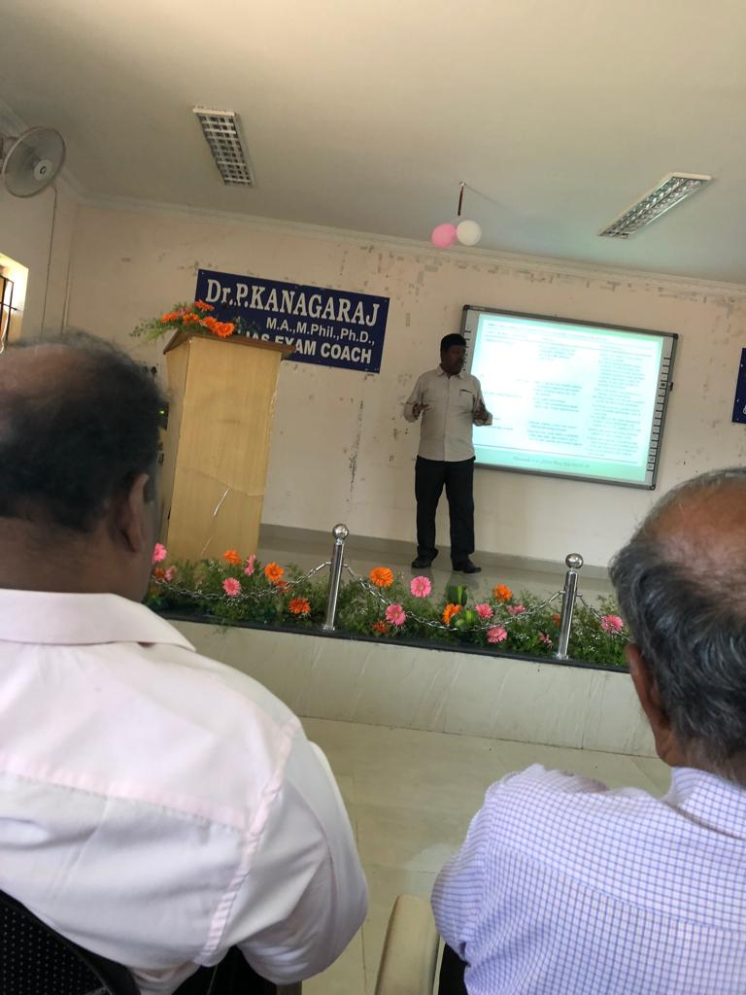
Wildlife Week Celebrations &
Zoology Association Function
Guest Lecture: Dr. P. Thangavel, Dept. of Environmental Science,
Periyar University, Salem
Topic: Phytoremediation of Metal-contaminated Soils

Slide 15
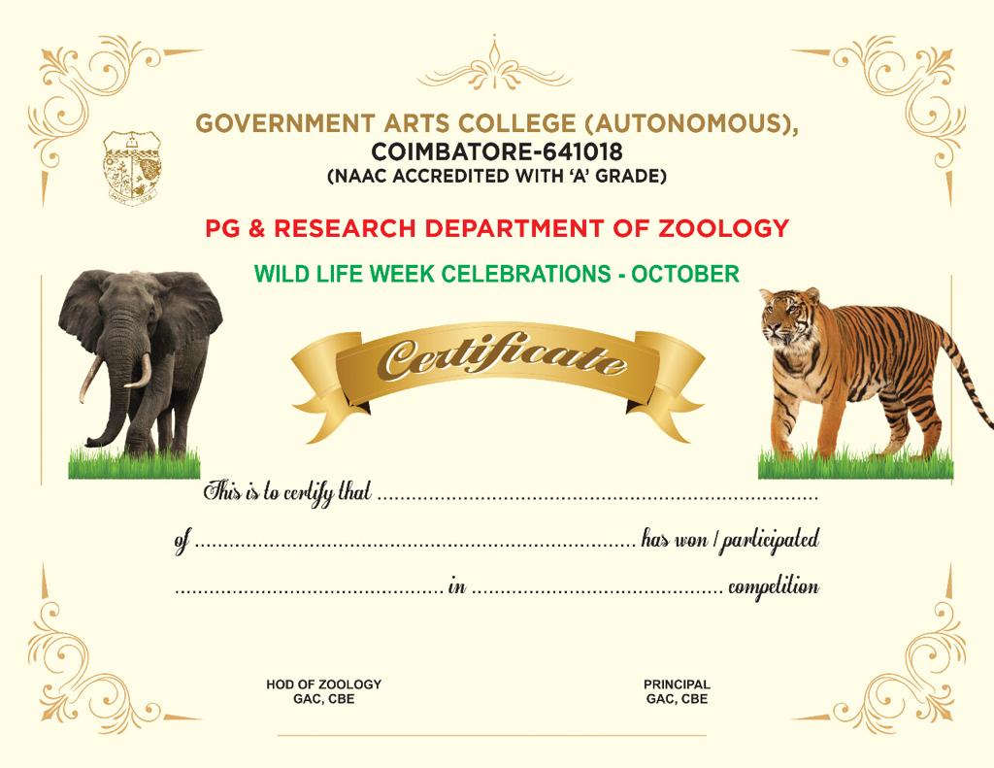
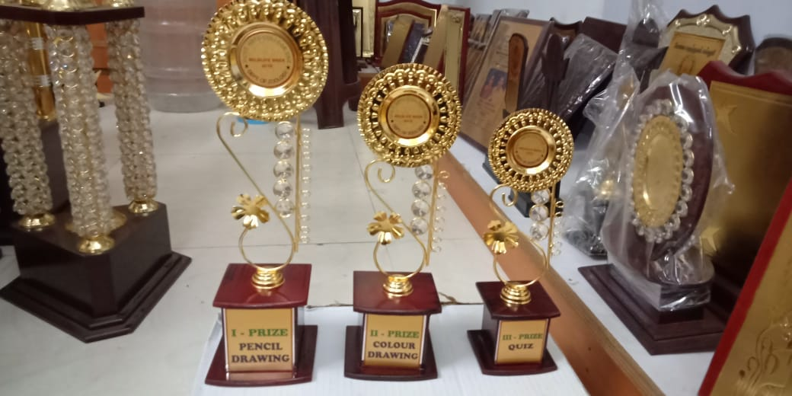
Wildlife Week Celebrations &
Zoology Association Function
Distribution of Prizes to Winners in the Competitions conducted during the Wildlife Week Celebrations

Slide 16
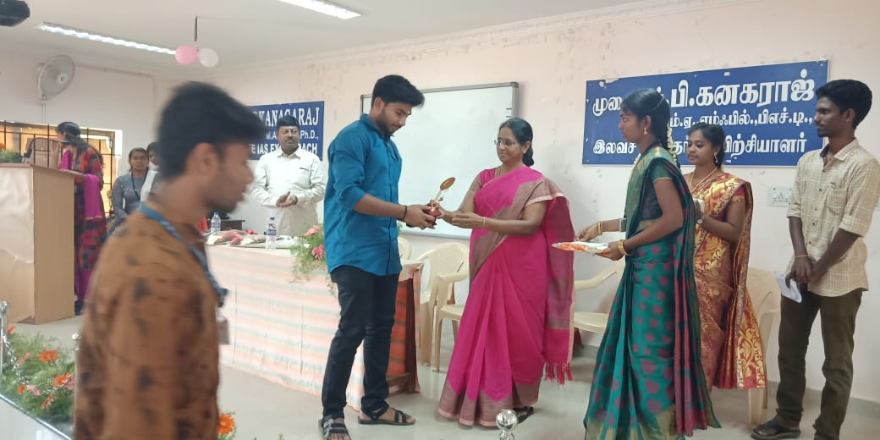
Wildlife Week Celebrations &
Zoology Association Function
Distribution of Prizes to Winners in the Competitions conducted during the Wildlife Week Celebrations

Slide 17
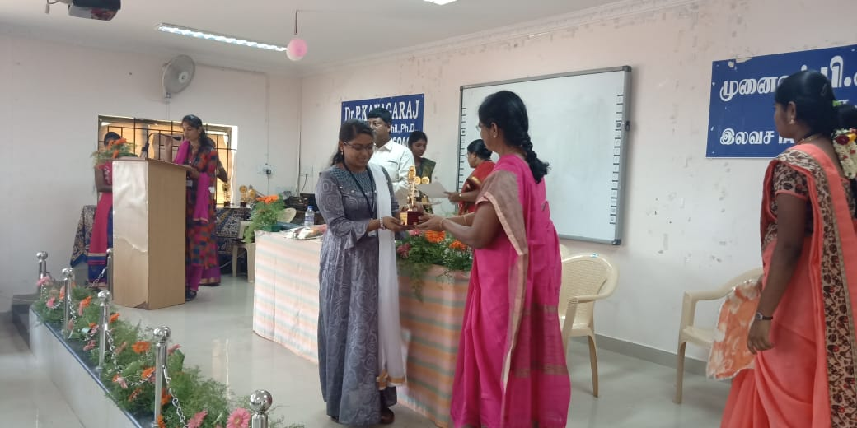
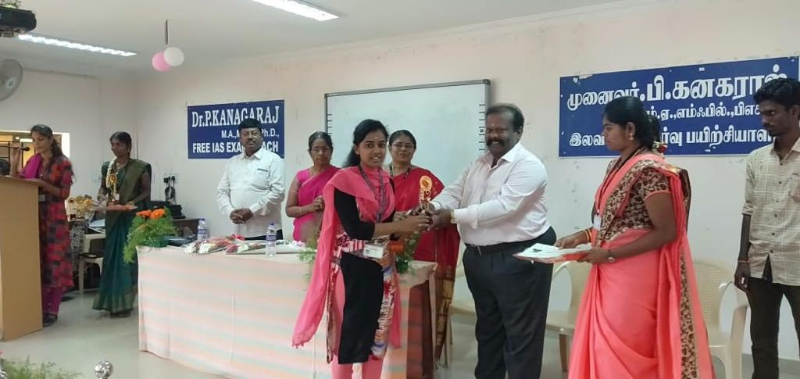
Wildlife Week Celebrations &
Zoology Association Function
Distribution of Prizes to Winners in the Competitions conducted during the Wildlife Week Celebrations

